Slide 1
Developing FinByte’s
API backend &
FinByte’s Trading Bot

Slide 2
About FinByte
FinByte is a fintech startup centered around growing one’s investment using algorithmic trading strategies.
Problem - Seeing continuous decline in interest rates of fixed deposits and increasing inflation rates in the country, there was a strong need for a firm which focuses on growing people's money and insuring their future. Current average FD interest rate is around 5% which is equal to the current inflation rate (which is going to increase in coming years). Investing money in FD is old-fashioned. FD no more grows your money and serves as safety only. So, the need for a safe medium which grows your money arises.

Slide 3
Algo Trading
Algorithmic trading, is a method of executing orders using automated pre-programmed trading instructions accounting for variables such as time, price, and volume. It is the process of using computers programmed to follow a defined set of instructions for placing a trade in order to generate profits at a speed and frequency that is impossible for a human trader.
Manual intervention is needed for placing orders as full automation is not permitted.

Slide 4
Introduction
FinByte API lets you execute orders in real time, manage user portfolios and stream live market data. All inputs are form-encoded parameters and responses are JSON (apart from a couple exceptions). The responses are Gzipped. Standard HTTP codes are used to indicate success and error states with accompanying JSON data. The API endpoints are not cross site request enabled, hence cannot be called directly from browsers.
An api_key + api_secret pair is issued and you have to register a redirect url where a user is sent after the login flow.

Slide 5
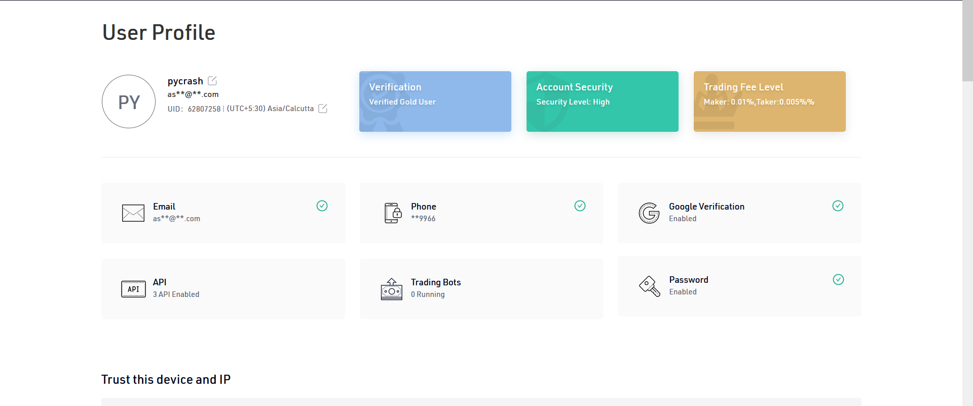
FINBYTE USER CONSOLE

Slide 6
FINBYTE
API BACKEND

Slide 7
Response Structure
All GET and DELETE request parameters go as query parameters, and POST and PUT parameters as form-encoded (application/x-www-form-urlencoded) parameters, responses from the API are always JSON.
A successful 200 OK response always has a JSON response body with a status key with the value success. The data key contains the full response payload.
A failure response is preceded by the corresponding 40x or 50x HTTP header. The status key in the response envelope contains the value error. The message key contains a textual description of the error and error_type contains the name of the exception.
Successful request
HTTP/1.1 200 OK
Content-Type: application/json
{
"status": "success",
"data": {}
}
Failed request
HTTP/1.1 500 Server error
Content-Type: application/json
{
"status": "error",
"message": "Error message",
"error_type": "GeneralException"
}

Slide 8
Exceptions
TokenException | Indicates the expiry or invalidation of an authenticated session. This can be caused by the user logging out, a natural expiry, or the user logging into another instance.
UserException | Represents user account related errors
OrderException | Represents order related errors such placement failures, a corrupt fetch etc
InputException | Represents missing required fields, bad values for parameters etc.
NetworkException | Represents a network error where the API was unable to communicate with the OMS (Order Management System)
DataException | Represents an internal system error where the API was unable to understand the response from the OMS to inturn respond to a request
GeneralException | Represents an unclassified error.

Slide 9
Common HTTP error codes
400 | Missing or bad request parameters or values
403 | Session expired or invalidate. Must re login
404 | Request resource was not found
405 | Request method (GET, POST etc.) is not allowed on the requested endpoint
429 | Too many requests to the API (rate limiting)
500 | Something unexpected went wrong
502 | The backend OMS is down and the API is unable to communicate with it
503 | Service unavailable; the API is down
504 | Gateway timeout; the API is unreachable

Slide 10
API rate limit
end-point | rate-limit
Historical candle | 3req/second
Order placement | 10req/second
All other endpoints | 10req/second

Slide 11
FINBYTE
TRADING BOT

Slide 12
Types of Bots
Following types of bot were made according to different trading strategies
Spot Grid
Futures Grid
Smart Rebalance
DCA
Own Strategy

Slide 13
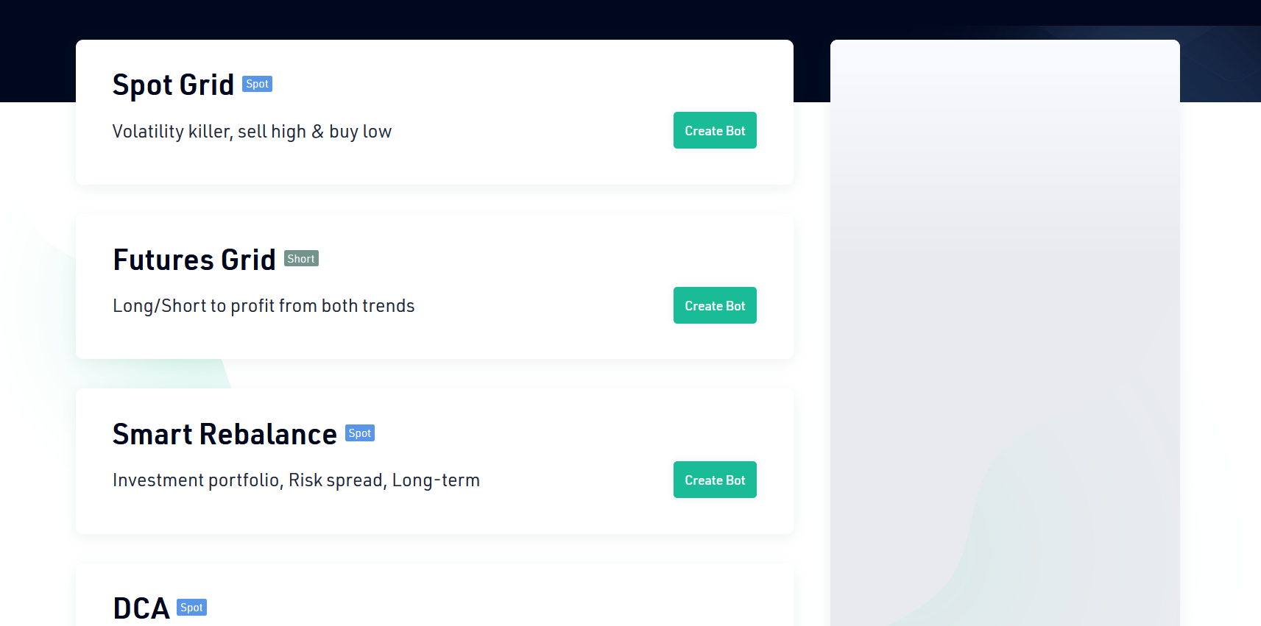

Slide 14
Spot Grid
It enables you to place a series of purchase and sell orders within a given price range. When a sell order is fully executed, the bot instantly places another purchase order at a lower grid level, and vice versa

Slide 15
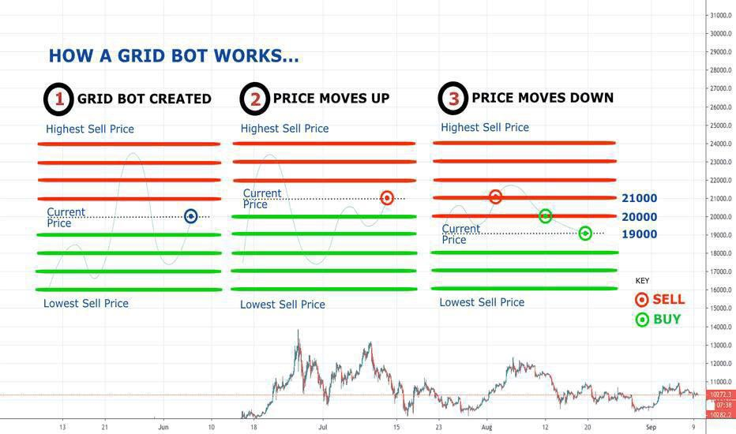
Image Src - https://miro.medium.com/max/3000/0*p51fjK_zppThXf9b.jpg

Slide 16
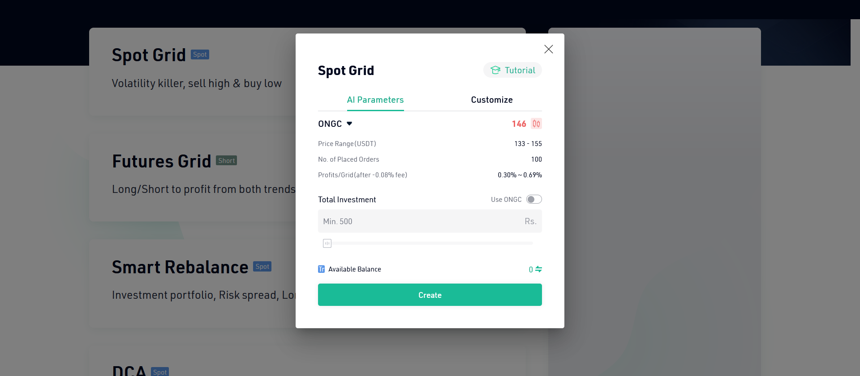

Slide 17
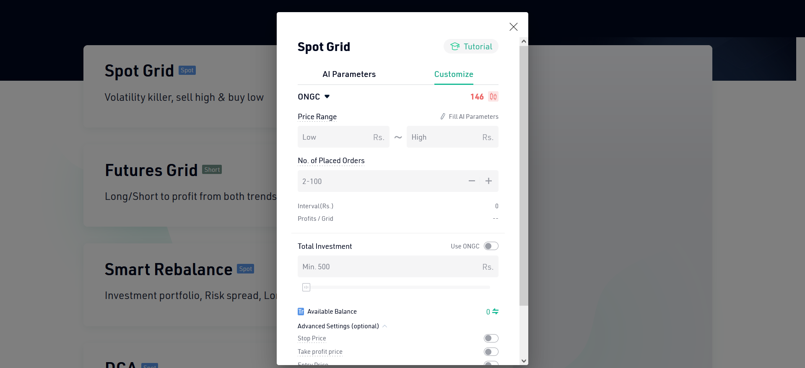

Slide 18
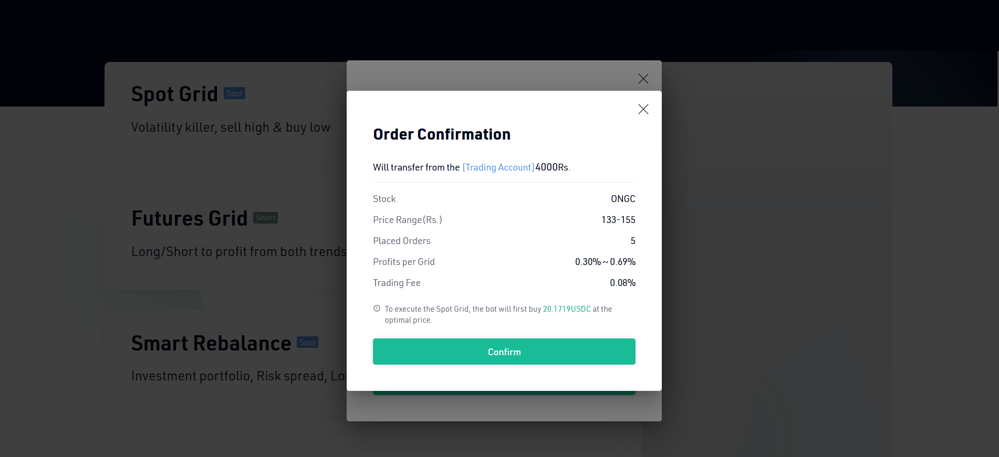

Slide 19
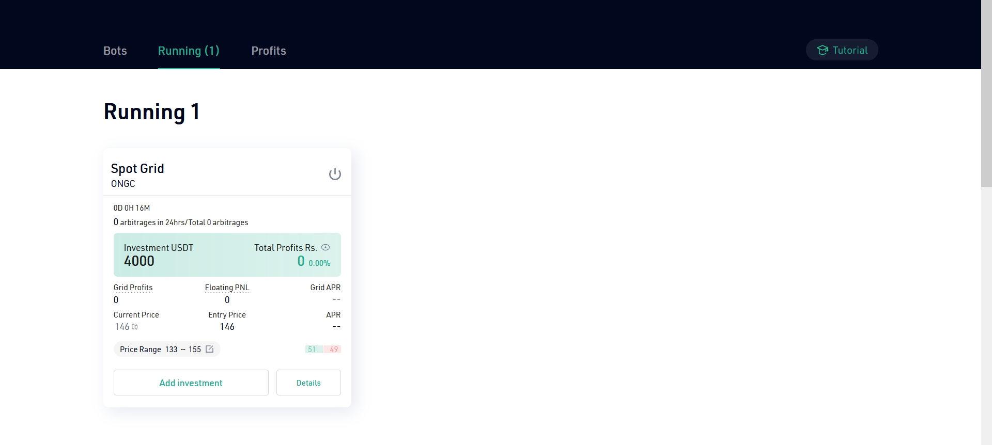

Slide 20
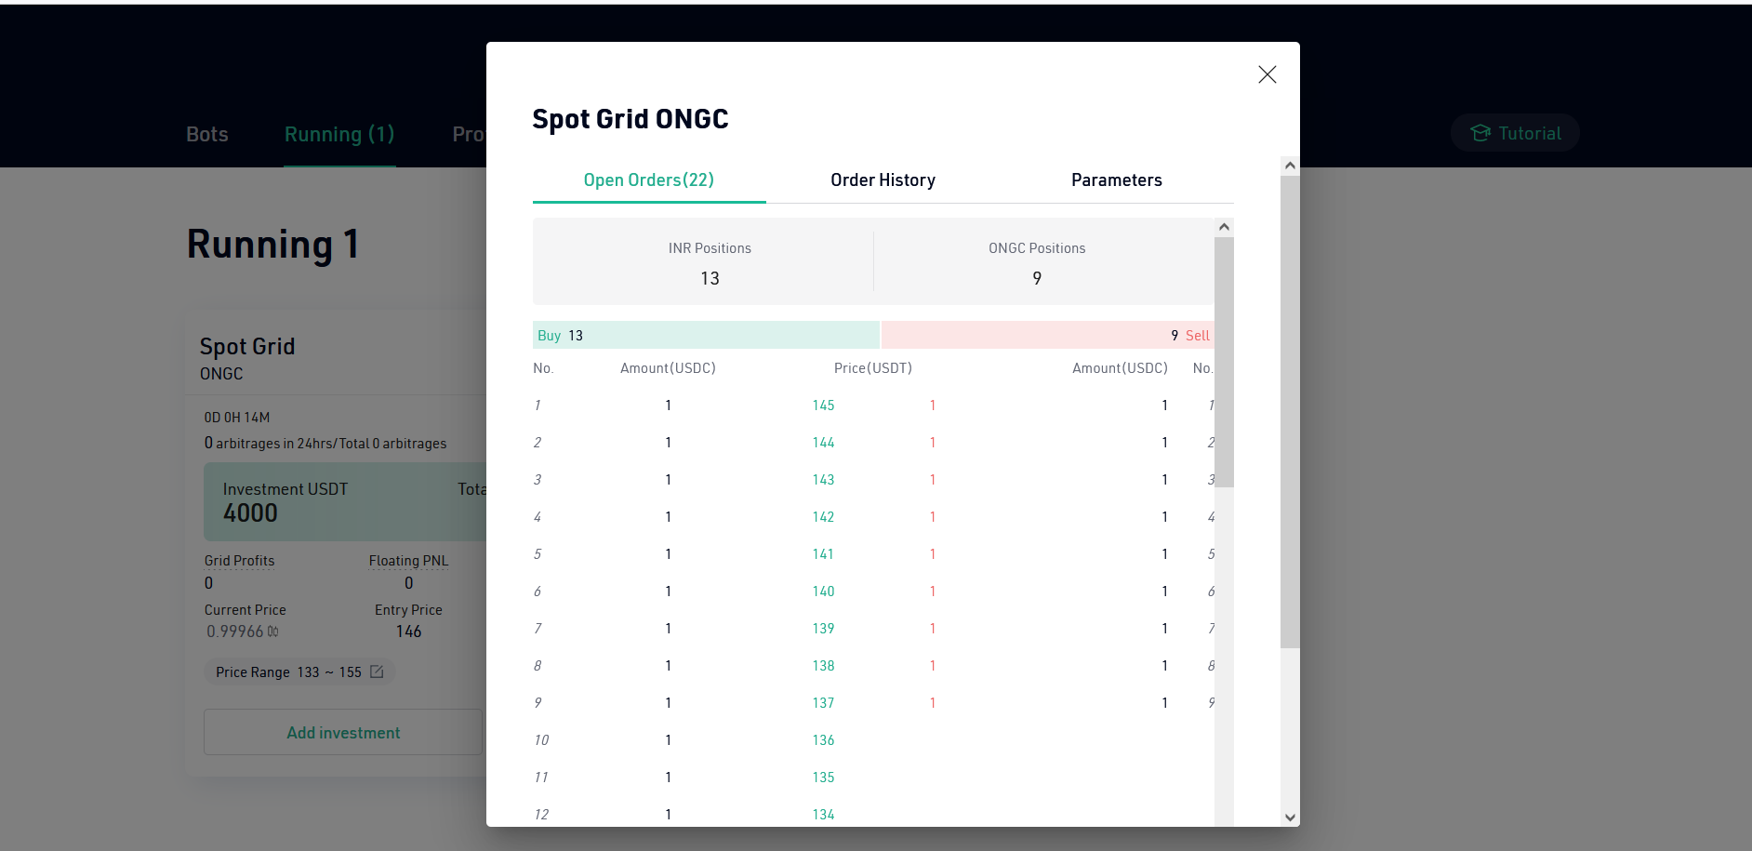

Slide 21
Futures Grid
The way a Futures Grid Bot works is similar to a Classic Grid Bot, both of them can make passive income by buying low and selling high. But Futures Grid has two unique features that can help investors make more profits.
The Futures Grid Bot allows you to long or short when starting the bot.
Leverages are supported on Futures Grid. Presently, it supports up to 2 times leverage, which can increase the returns of your success trades by 2 times.
Higher returns imply higher risks.

Slide 22
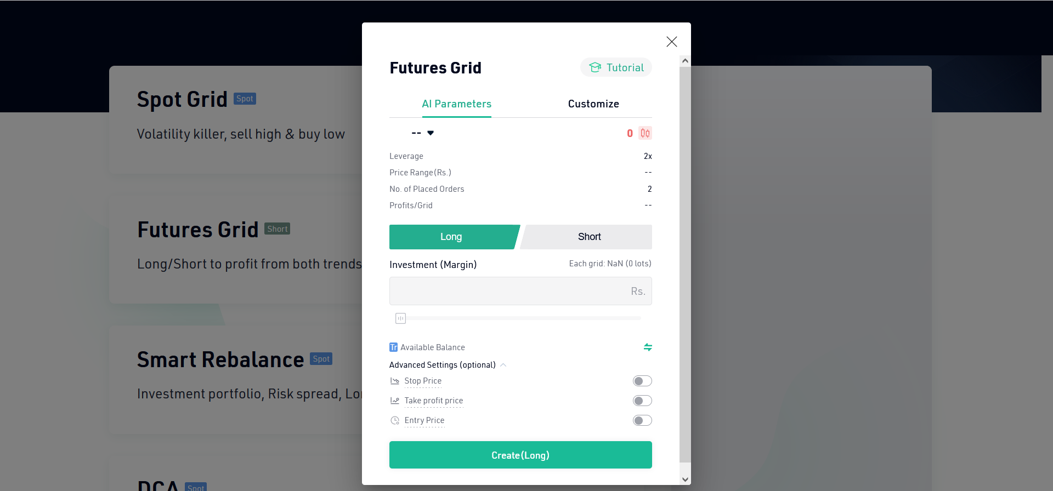

Slide 23
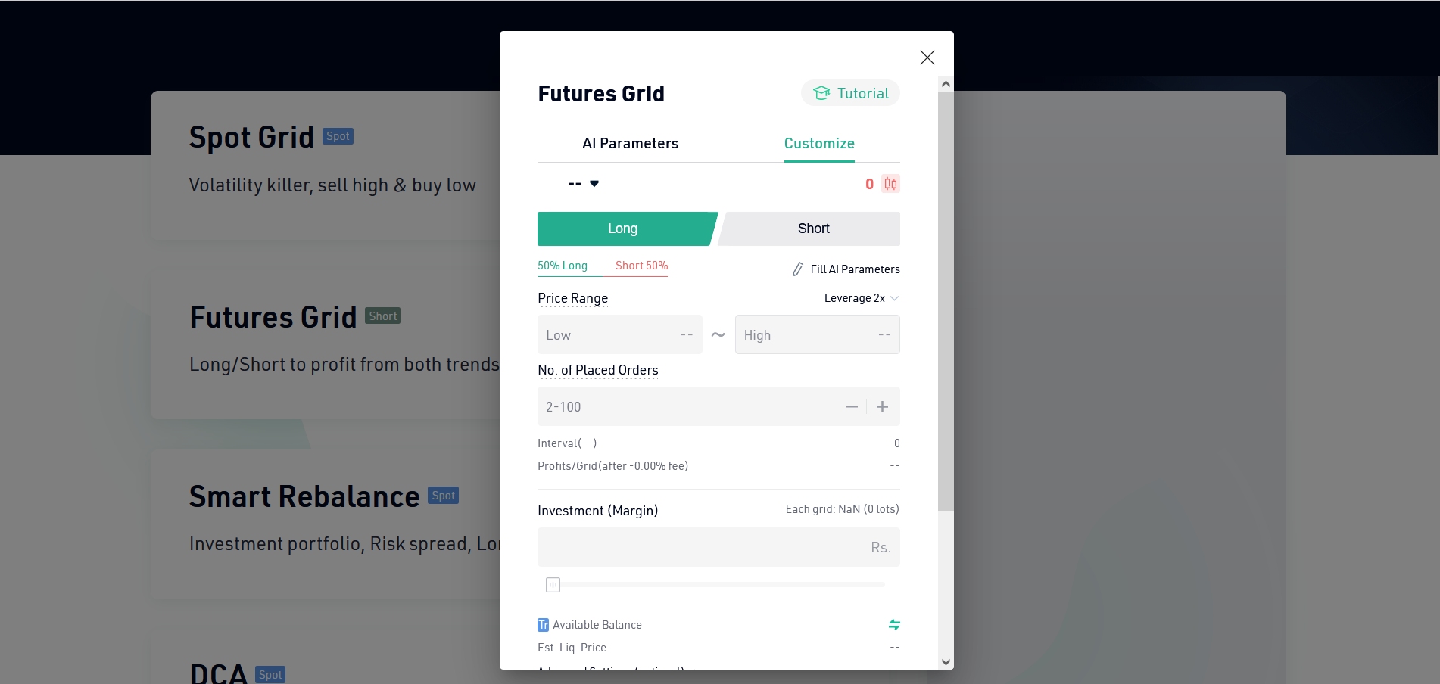

Slide 24
Smart Rebalance
The core of this strategy is to increase the total amount of assets while maintaining the portfolio percentage basically unchanged. Assuming that you want to allocate 40% of your fund to ONGC, 30% to AIRTEL and 30% to TATA STEEL, if you are simply holding, the value of these tokens may change over time and the portfolio percentage will soon no longer be 40% - 30% - 30%. With a Smart Rebalance Bot, the percentage can always be close to your expectation as once it deviates from the initial setting, the bot will make a rebalance.

Slide 25
Smart Rebalance (Cont’d)
Let’s say your portfolio percentage has changed from 40% - 30% - 30% to 45% - 30% - 25%, the bot will then sell some ONGC to reduce its percentage from 45% to 40%, meanwhile buy some TATA STEEL to make it back to 30%. In a sense, grid trading is to buy low and sell high between two tokens, while Smart Rebalance is to do so among all the tokens in your portfolio.

Slide 26
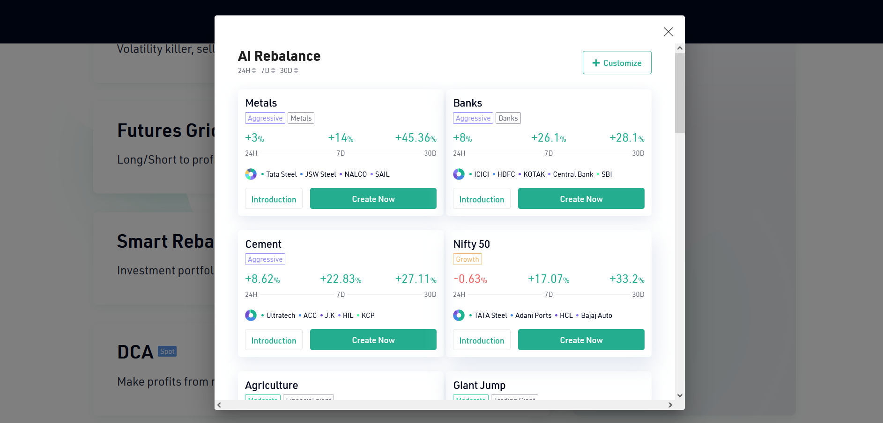

Slide 27
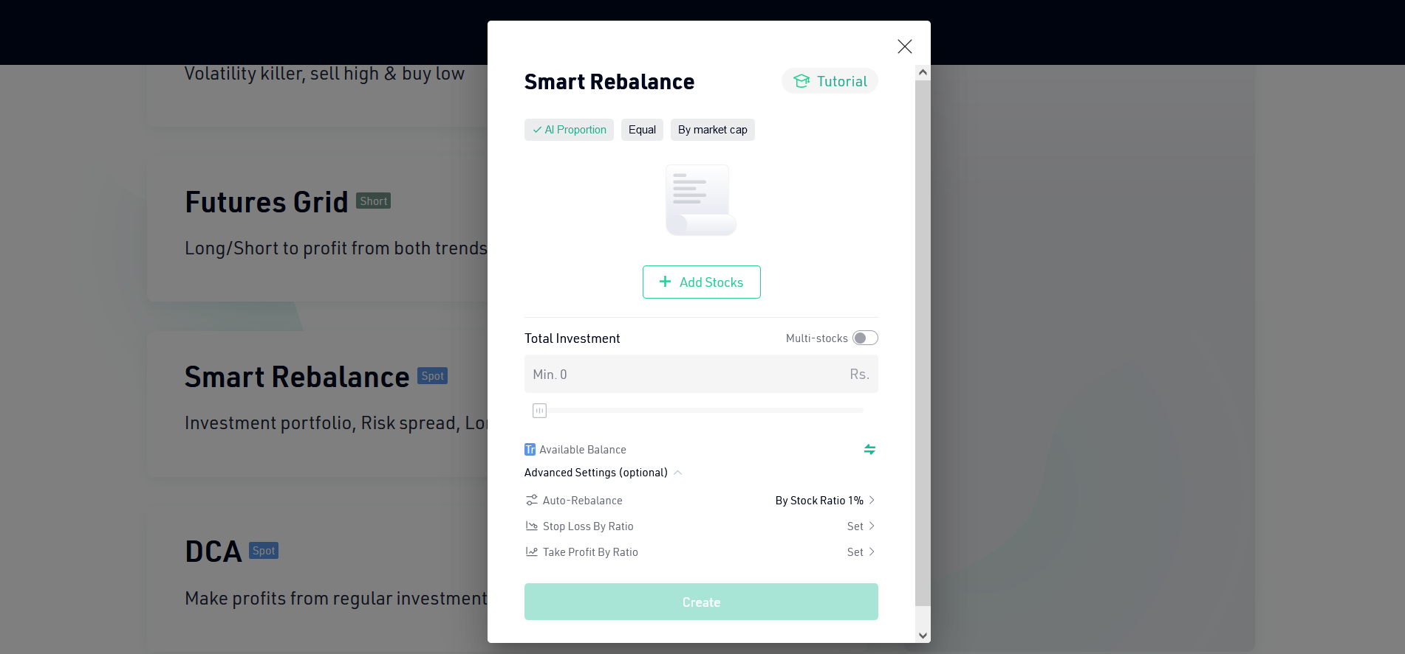

Slide 28
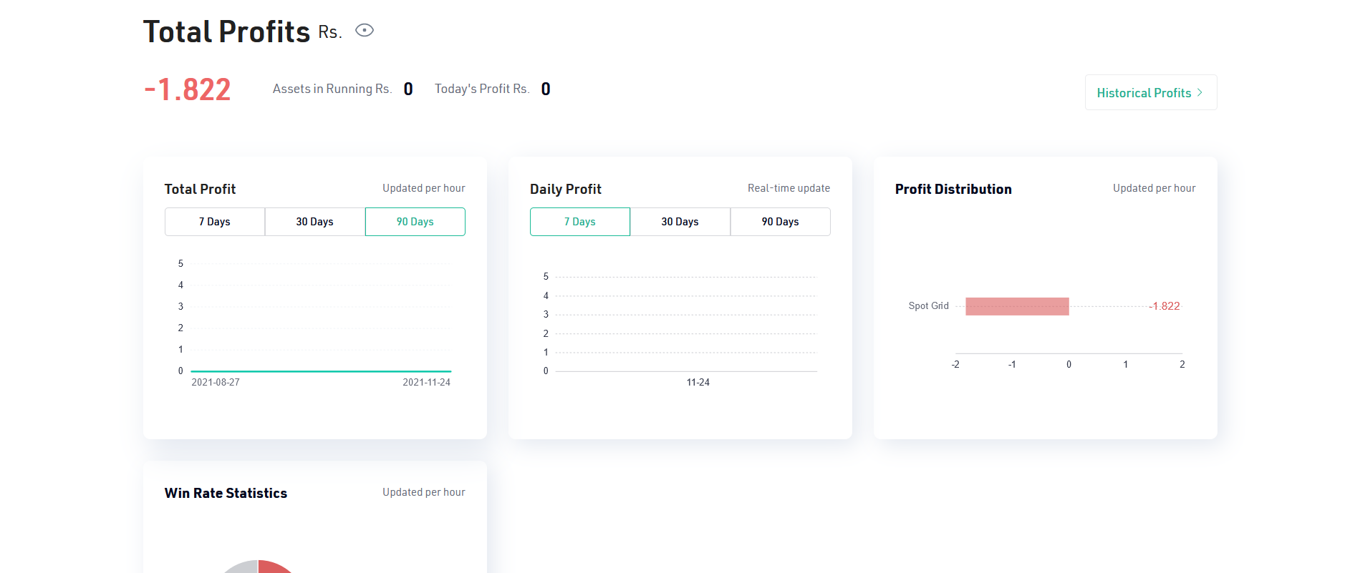
USER’S PROFIT CONSOLE

Slide 29
THANK YOU

